Slide 1
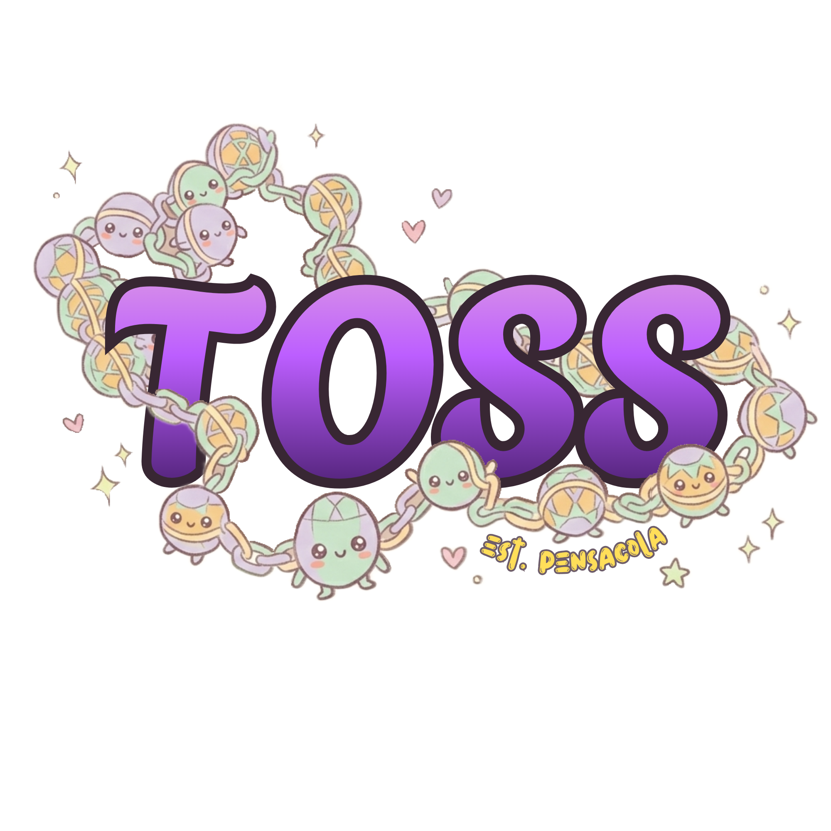
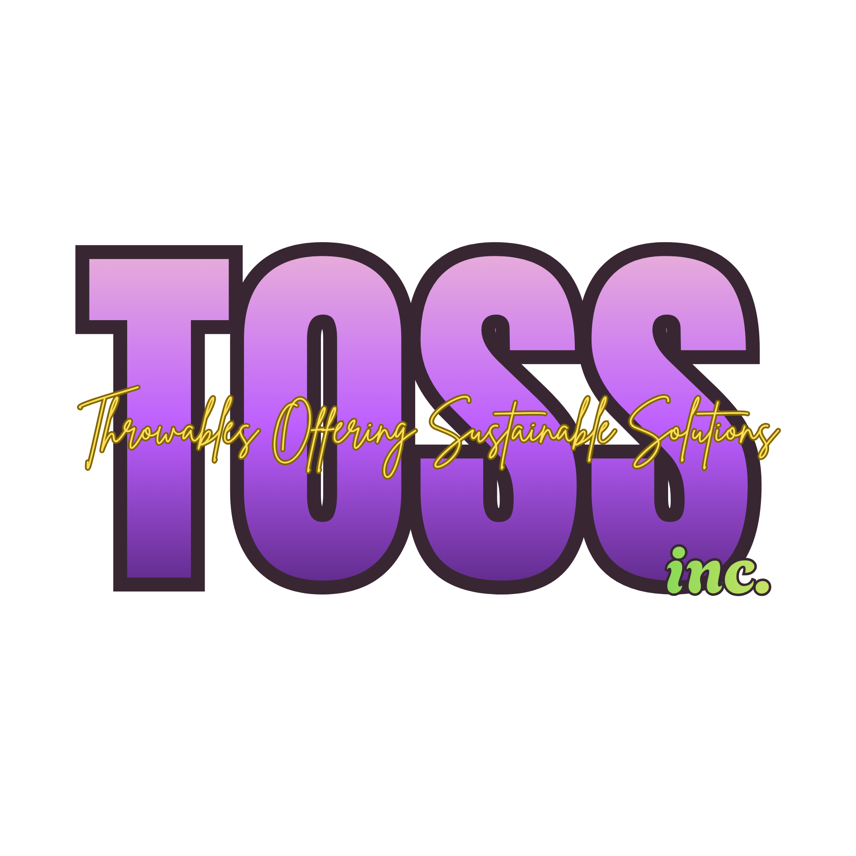
TOSS inc.
Jones Moore & Elana Millhouse-Smith

Slide 2
Business Description
TOSS Inc. (Throwables Offering Sustainable Solutions) is a Florida nonprofit corporation dedicated to reducing the environmental impact of traditional Mardi Gras celebrations. Each parade season, krewes distribute massive quantities of single use plastic beads and throws, much of which ends up in landfills and local waterways, TOSS Inc. was made to address this problem.
By partnering with Louisiana State University's, their PlantMe Beads program can supply biodegradable throw alternatives to krewes and parade organizations free of charge — making sustainable choices as accessible as their plastic counterparts. Funded entirely through charitable donations, TOSS Inc. is working to prove that Gulf Coast tradition and environmental responsibility can coexist, one parade at a time.

Slide 3

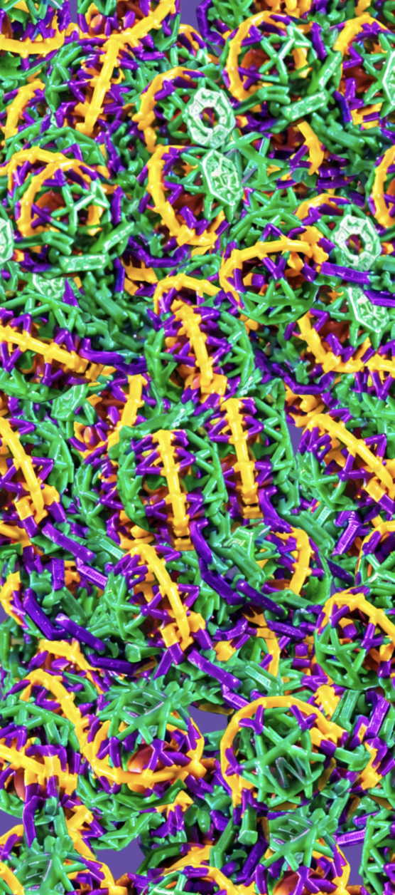
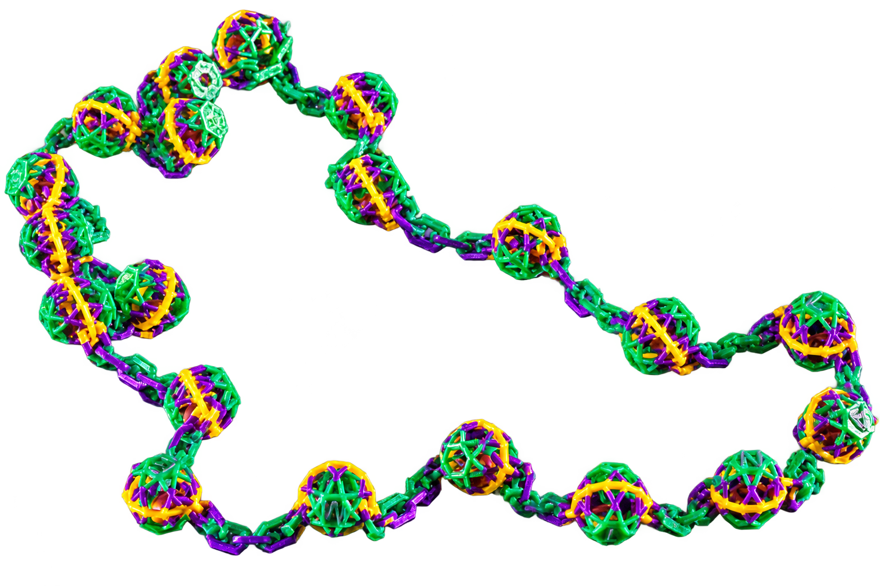
Progress!
Progress!
$3,000
$2,000
$1,000

Slide 4
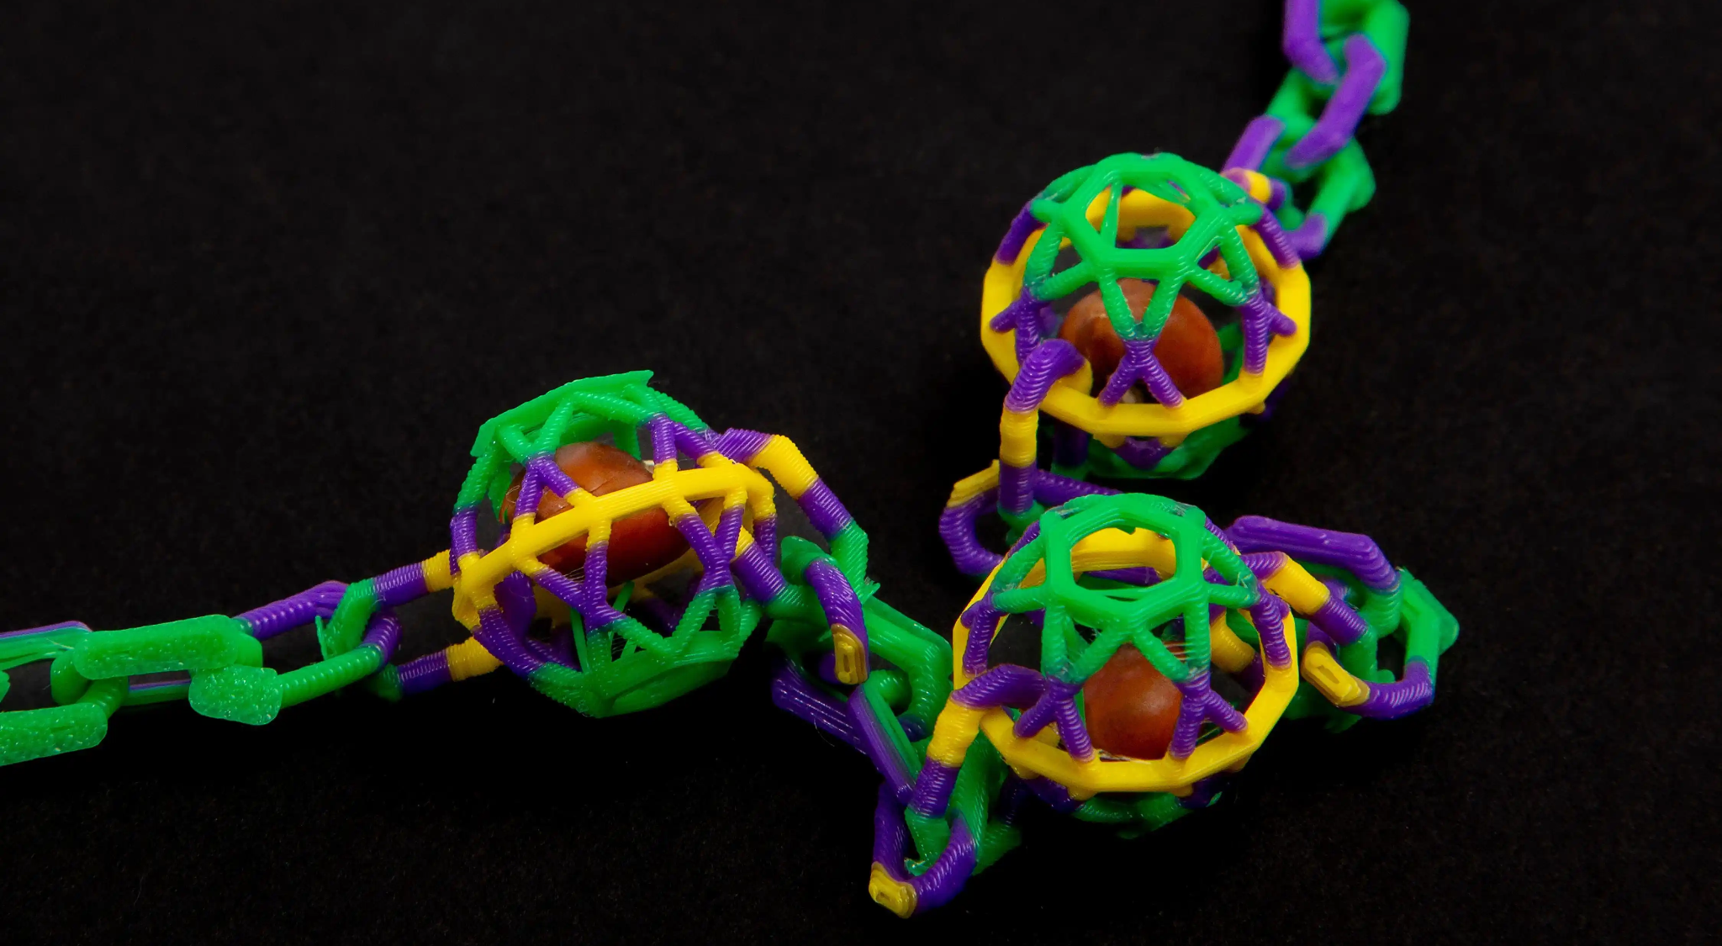
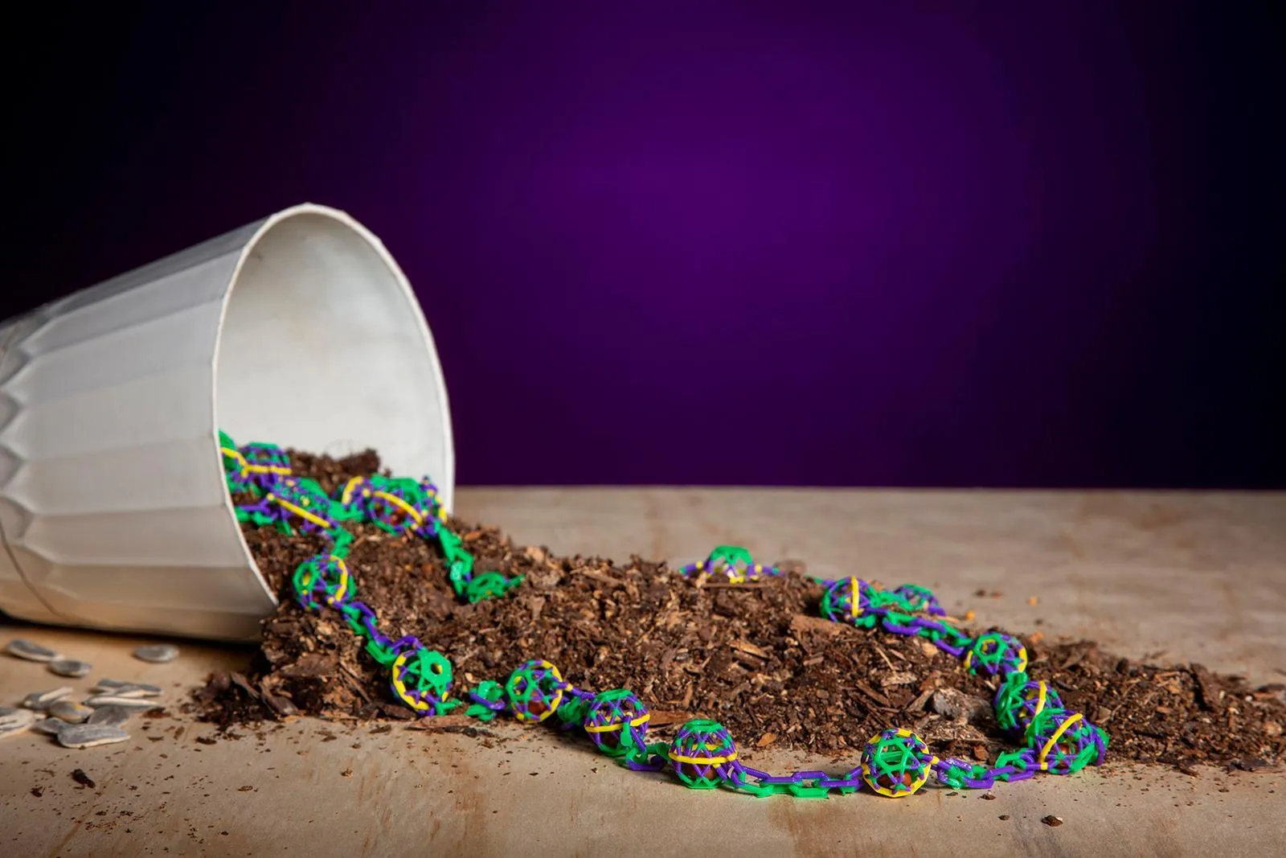
Contact Us!
Donate Today!
TOSS Inc. is a Pensacola, Florida-based nonprofit working to eliminate single-use plastic from Mardi Gras celebrations by providing biodegradable throw alternatives to krewes and parade organizations across the Gulf Coast.

Slide 5
Contact Us At:
Email Us: TOSSpensacola@gmail.com
Text Us: +1 (850) 293 - 7426

